Slide 1



SaveABite
Feasibility Analysis
CSE 3412: System Analysis & Design Lab
Safyal Muznabin Ratul
Sumaiya Sadika
Saptarshi Biswas Supty
Sourav Saha
Urbashi Biswas

Slide 2


1. Survey Attendee Statistics
Total Respondents: 31
Method: Online Google Form
Primary Demographic: 90% Students, 10% Restaurant Owners and Corporate workers
Device Usage: 70% Mobile (Android/iOS)
Target Audience validated: Students are the primary volunteer force.

Slide 3
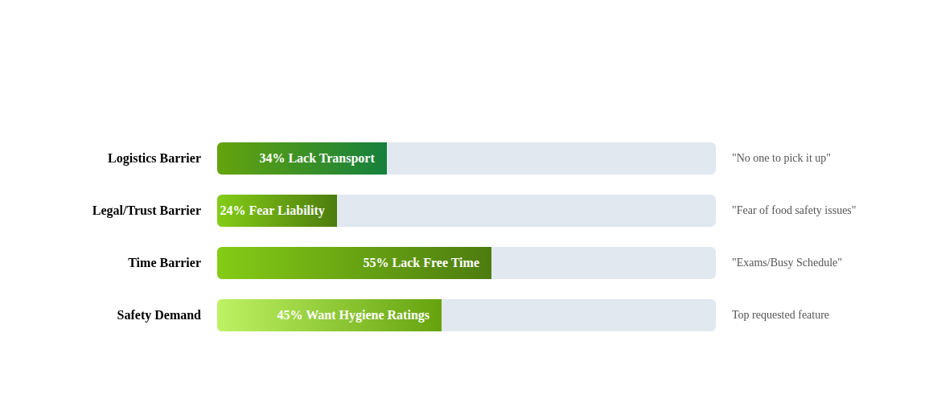
2. Survey Results: Key Insights
We identified 3 critical feasibility barriers from the data:

Slide 4

3. Comprehensive Feasibility Analysis
Technical
Economic
Requirement: Geo-location & real-time updates.
Requirement: Sustainable Logistics Funding.
Data Support: 69% of users are on smartphones. 76% are willing to enable location services for rescues.
Data Support: 72% of users are willing to pay micro-donations (e.g., 50 BDT) to sponsor volunteer rickshaw fares.
Legal/Safety
Operational
Requirement: Trust & Food Safety.
Requirement: Volunteer Availability.
Data Support: 52% only trust "known sources."
Data Support: "Lack of time" is the #1 barrier.
Mitigation: Mandatory "Hygiene Ratings" (requested by 13 users).
Solution: Hyper-local (< 2 km) matches to reduce task time.

Slide 5


4. Feasibility: Feature Selection
Selected Features
Discarded Features
Hygiene Ratings: Essential for the 52% of users who are skeptical about safety.
Impact Statistics (CO2): Reason: Only 2 votes. Users care about personal rewards (CV/Vouchers).
Expiry Timers: Critical to address the "Fear of Liability" donor barrier.
Complex Verification Badges: Reason: Low interest (1 vote). Users prefer peer-ratings over static badges.
Rickshaw Fare Fund: Validated by 72% willingness to pay.
Masked In-App Chat: Rated "Mandatory" by student volunteers for privacy.

Slide 6
5. SWOT Analysis & Strategy
Strengths (Internal)
High student volunteer-based (90%)
Community willingness to fund logistics (72%)
Weakness (Internal)
Volunteer time constraints (Exams)
Privacy concerns (24% hesitant on location).
Opportunities (External)
High demand for Discount Vouchers
Gap in market for “Transport-included” donation.
Threats (External)
Food safety incidents (Liability)
Competitor platforms (though they lack logistics).
Final Strategy: “Focus on a hyper-local mobile app to solve the Time Barrier, using mandatory hygiene ratings to solve the Trust Threat, and gamification (CV/Vouchers) to maintain student engagement.”

Slide 7
Thank You
Questions?

